Slide 1

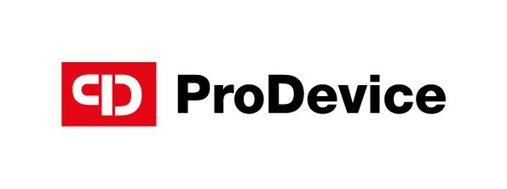
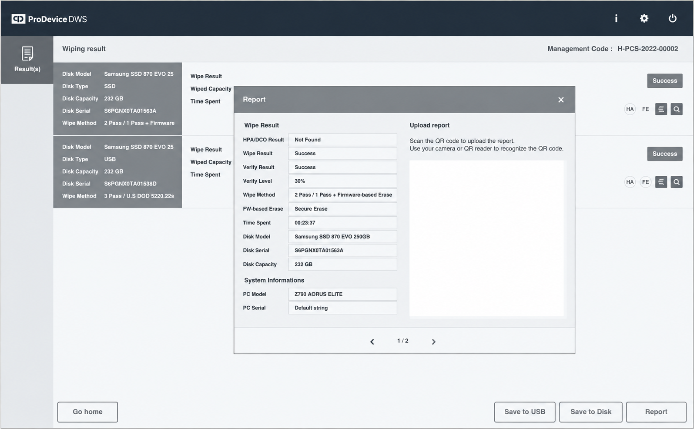
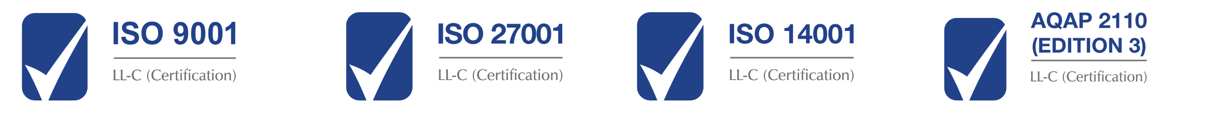

BE AWARE – CHOOSE WISELY
ProDevice DWS
software for data destruction
ProDevice DWS (Data Wipe System) is a software designed for the permanent destruction of data stored on data media through controlled overwriting. This process results in the irreversible removal of information, preventing it from being recovered using standard methods or specialized digital forensics tools. Once the operation is completed, the storage media remains fully functional and can be reused to store new data.
ProDevice DWS is part of the ProDevice ecosystem, which includes products used for the storage, transportation, data erasure, and physical destruction of storage media, as well as software solutions that enable the management of processes related to data security
Benefits
Data protection
Permanent data destruction from storage media minimizes the risk of confidential data leakage and its recovery after the media has been decommissioned.
Compliance with requirements
Secure data destruction follows compliance with applicable regulations and internal organizational policies concerning information protection and the secure disposal of data.
Cost optimization
With the rising costs of storage media, securely erasing and reusing existing media can help reduce IT infrastructure expenses.
Secure data erasure. Anywhere in the world.
No shipment of storage media. No international travel. No geographical limitations.
Do it yourself.
Your infrastructure. Your team. Full control.
Purchase DWS licenses and perform secure data erasure directly within your own IT environment. Keep the entire process in-house, maintain full control over your data and securely return erased media to service.
Let a ProDevice Partner do it for you.
Your data stays where it belongs.
A local ProDevice Partner can bring the DWS service directly to your premises and perform secure data erasure within your controlled environment. No need to ship sensitive media outside your organization. The technology and expertise come to you.
Erase remotely. Anywhere in the world.
Your infrastructure can be thousands of kilometers away. The service doesn't have to be.
With an appropriately prepared secure remote-access/KVM environment, ProDevice specialists can perform the data erasure process remotely. No shipment of storage media. No international travel. No geographical limitations.
V.DWS.2026.1
Facility Security Clearance Certificate

Slide 2
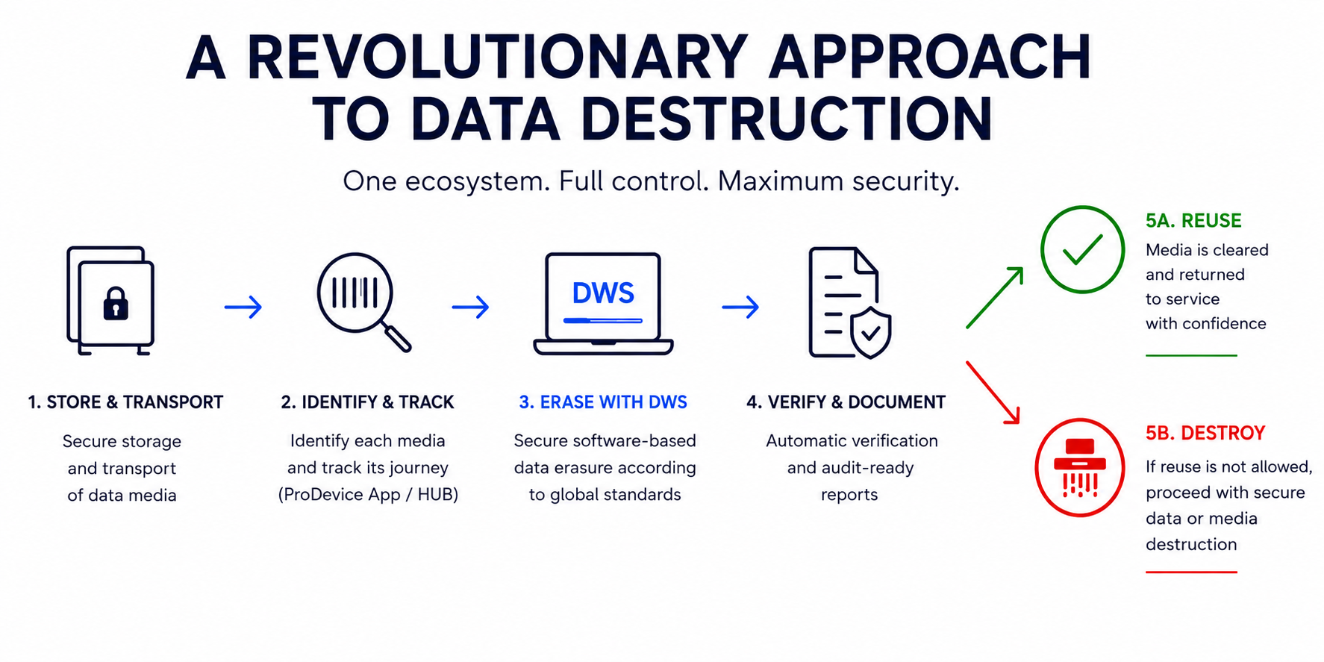
Software-based data erasure
Application:
Decommissioning of IT equipment.
Resale of computers or servers.
Return of leased equipment.
Handover of for servicing or repair.
Reassignment to another employee.
Recycling of storage media.
ProDevice DWS helps organizations implement secure media sanitization processes within an ISO/IEC 27001, NIST SP 800-36 and NIST SP 800-88 Rev. 2. aligned information security framework.
ProDevice DWS recommended system specifications
ProDevice DWS
Supported interface | IDE/ATA, SCSI, SAS, SATA, NVMe
Supported media | Internal and external HDD, SSD Removable media such as USB memory, SD card * Optical disks such as CD-RW and DVD-RW cannot be wiped.
Supported hardware | PCs based on x86 and x86-64 architecture, BIOS and UEFI systems
PC Memory (RAM) | 4 GB or higher
Supported languages | English
Supported resolution | 00 x 600 or higher
Free space | 10 GB or higher ※ If you use the [Wipe my PC disk] option, you need at least 10 GB of free disk space. If you don't use this option, you only need 4 GB of free space.
The manufacturer reserves the right to update, improve, provide additional functionality, or otherwise introduce changes to the design of any products deemed necessary by the manufacturer.
www.pro-device.com
e-mail: info@pro-device.com
Hotline: +48 122 919 101
Product description is for information purposes only and does not constitute an offer to sell.

